Slide 1
WELCOME
to the University of Montana Phyllis J. Washington College of Education!
Notes:
Dan– PJW history goes here

Slide 2
Introductions
In your groups, please take turns sharing the following:
Your name and hometown
Why you are interested in becoming an educator
What part of UM/Missoula are you most excited to experience this year?
Notes:
Ray TES
Torey Admin and Scholarships
Bailey Wellbeing
Jamie Website

Slide 3
OUR PROGRAMS
Early Childhood Education
Elementary Education
Secondary and K-12 Education
Notes:
Ray and Bailey

Slide 4
RESOURCES
We’re here to support you!
Teacher Education Services
Administrative Services
Scholarships
Wellbeing Support Coach
  Allie Jellison
Website & Newsletters
Notes:
Ray TES
Torey Admin and Scholarships
Bailey Wellbeing
Jamie Website

Slide 5
Phyllis J. Washington Scholars Program
Applications will open in late January 2026...watch the newsletters for updates!
Benefits:
  Loan repayment
  Increased training in positive psychology and positive education
Application Requirements:
  Fall 2025 GPA of 3.7 or higher
  500-word essay (prompted)
  Interview with the selection committee
Don’t wait to get started! Register for EDU 291 “Special Topics: The Psychology of Happiness” this fall!
Notes:
Torey

Slide 6
Our Shared Place
Stop by the TES suite
Recess Coffee Shop
Study on any of the three floors
Notes:
Mike

Slide 7
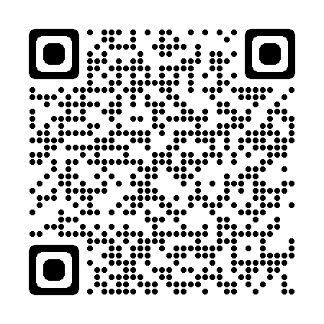
LEARN MORE:
www.umt.edu/education/

Slide 8
QUESTIONS?

Slide 9
Scavenger Hunt!
Follow the clues and send your photos to jamie.mcnally@mso.umt.edu
Notes:
Mike

